Slide 1

DATA ANALYTICS INTERNSHIP PROJECT NAME: SWARAJ VERMA
Final Project
Sales Data Analysis and Reporting for a Retail Chain

Slide 2
INTRODUCTION
Project Plan
The aim of this project is to use Python, SQL, and Excel to analyze sales
data and generate meaningful reports for a retail chain.
: Data Collection and Database Setup
1.Data Collection: Download the data from Kaggle as a csv file and
place it on the proper path
2.Database Setup: Set up a SQL database to hold the data. Design
the database schema, and create the necessary tables using SQL
DDL commands.

Slide 3
Data Analysis
How it works:
Title: Project Overview ✅ Content:
Objective: Analyzing retail sales data to gain insights
Phases of the project:
Data Collection & Database Setup
Data Cleaning & Preparation
Data Analysis
Reporting
1
Slide 3: Data Collection
✅ Title: Data Collection ✅ Content:
Source of Data: Kaggle Retail Dataset
File Format: CSV
Path: C:/Program Files/MySQL/MySQL Server 8.0/Uploads/Retail_Data_Transactions.csv
Tools Used: Python (pandas), SQL

Slide 4
Phase 2: Data Cleaning and Preparation
Data Cleaning and Preparation
1. Data Cleaning: Use SQL queries and Python (pandas) to clean the
data. Look for and handle missing or inconsistent data, outliers, etc.
2. Data Preparation: Prepare the data for analysis. This may involve
creating additional calculated fields, such as total sales value,
month/year fields for time-based analysis, etc. Again, this can be done
using a combination of SQL and Python.
Files:

Slide 5
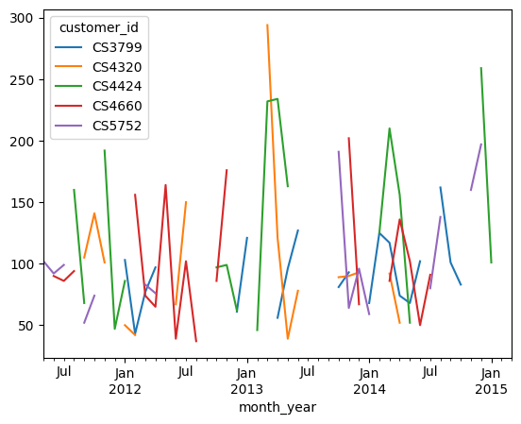
PHASE
Phase 3: Data Analysis
1. Data Exploration: Use SQL queries and Python (pandas, matplotlib,
seaborn, etc) to explore the data and identify trends and patterns.
2. Advanced Analysis: Perform more complex analysis as needed. For
example, time series analysis for sales trends, cohort analysis for
customer behavior, etc. Python's advanced data analysis libraries can
be very useful here.

Slide 6
Phase 4 : REPORTING
1. Report Preparation: Prepare reports summarizing the findings. These can include:
• Tabular Reports: Create summary tables showing sales by product, store, month, etc. These
can be generated using SQL queries and Python, and then formatted and presented in Excel.
• Visual Reports: Create visual reports (charts, graphs, etc) showing trends and patterns. These
can be created using Python's data visualization libraries, and then incorporated into Excel for
presentation.
• Automated Reports: If needed, set up automated reports that run regularly and update Excel
dashboards, using Python for automation.
2. Report Presentation: Present the reports to in either your Excel dashboard or prepare a PPT to present the findings.

Slide 7
CONCLUSION
1. Data-Driven Decision Making
Sales data analysis helps optimize transaction, customer, and marketing strategies.
2. Business Impact
Improved customer segment through segmentation.
Increased sales & retail through data-driven marketing
3. Enhanced Reporting & Automation
SQL & Python streamline data Preprocessing.
GOOGLE DRIVE LINK1: https://drive.google.com/drive/folders/14KniElx-_mrMDSmo4TehyRLQzQc_1qXM?usp=drive_link
GOOGLE DRIVE LINK2: https://drive.google.com/drive/folders/1vVpTy0aEAivjWRVXMG5XcabJkfotYI66?usp=drive_link

Slide 8
THANK YOU

